Slide 1
Capstone Project Finance and Risk Analytics
DSC30
Abhinav Ruprao Kale
kaleabhinav08@gmail.com

Slide 2
Objectives
To make portfolios which should be in-line with the client’s goal and risk appetite

Slide 3
Time Period and Market Index
5 years
Data captured from 30-09-2015 to 30-09-2020
Market Index Used : S&P500

Slide 4
Market Index (S&P500) Performance
The Market has Recovered fast
Pandemic

Slide 5
Industries
Aviation
Finance
Healthcare
Pharmaceuticals
Technology

Slide 6
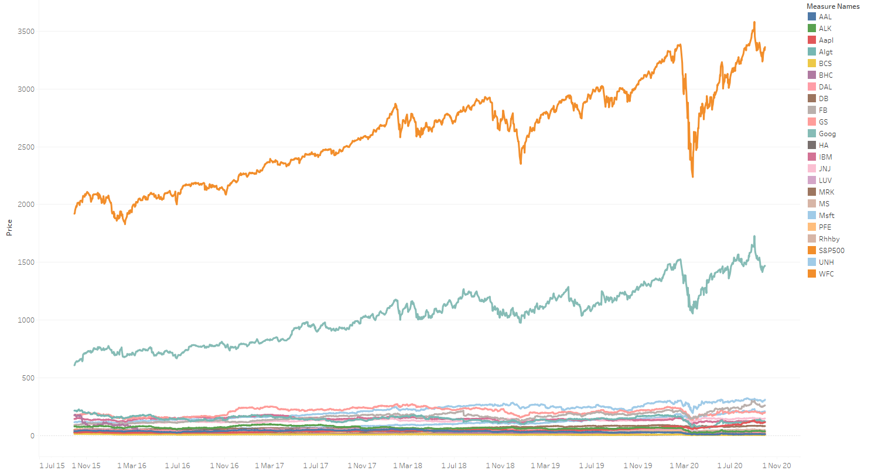
Plotting real values of stocks
Due to the difference in values of market index and other stocks we cannot properly visualize the performance
To tackle this problem, the values we normalized the values
Market Index

Slide 7
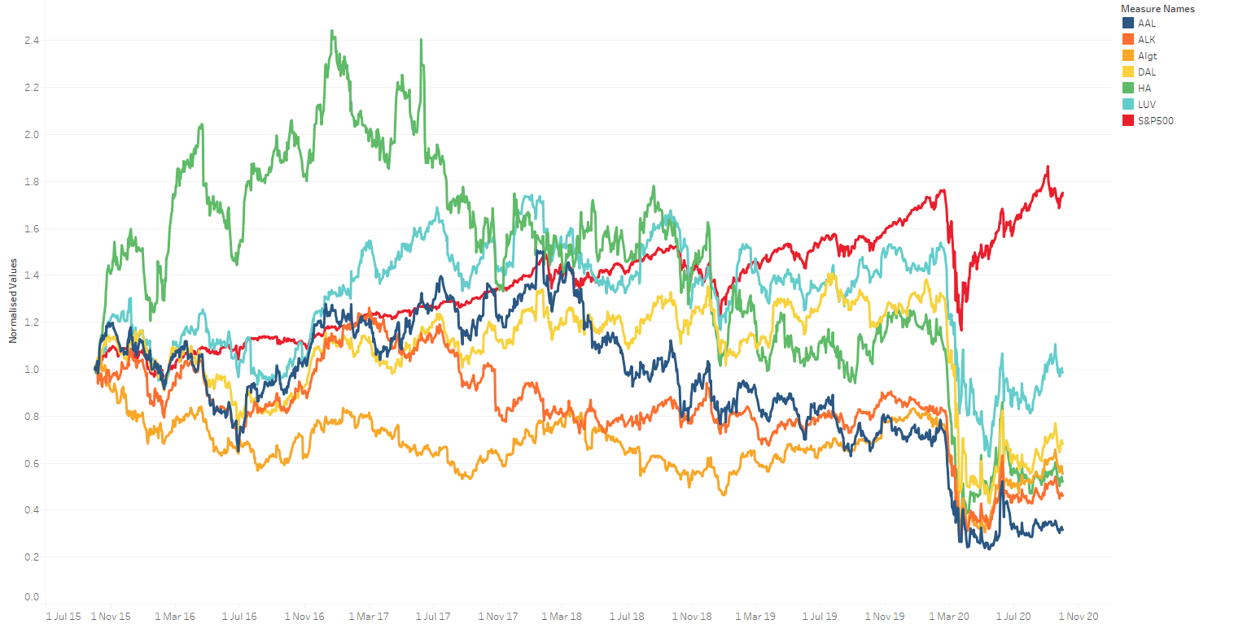
Aviation
It seems the COVID restriction of travel ban has hit the Aviation industry hard.
These stocks can be recommended to someone with greater risk appetite

Slide 8
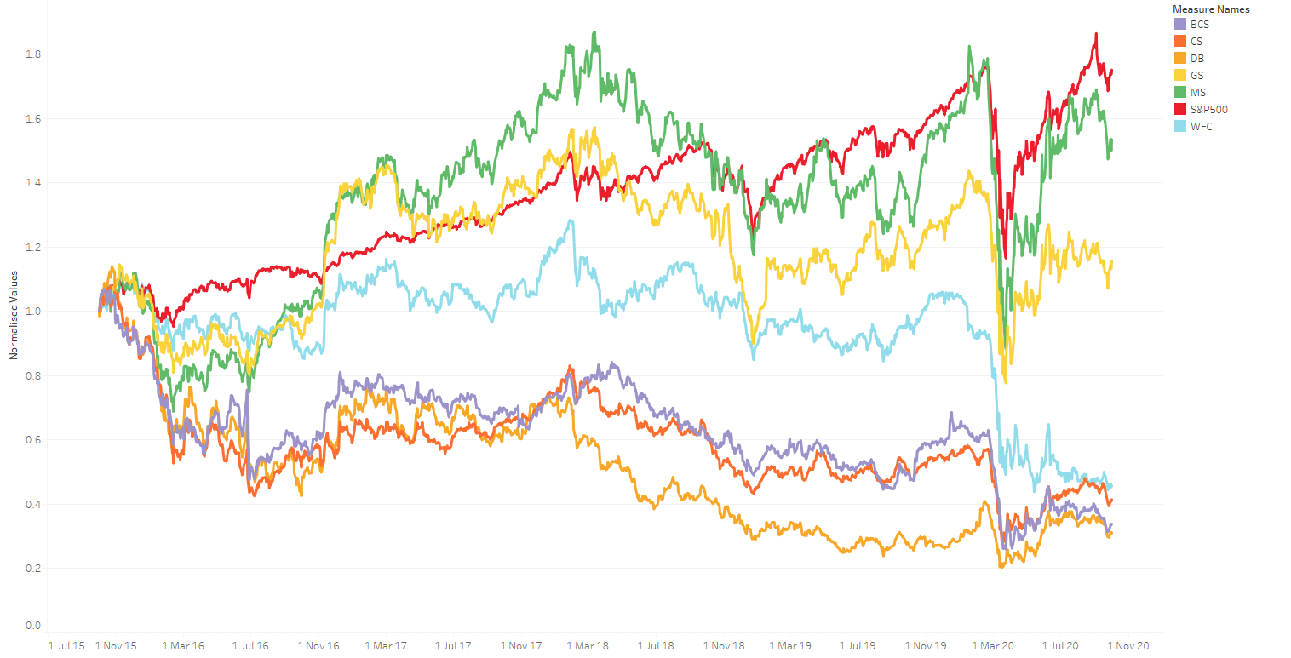
Finance
Some of the financial companies seems to have followed the market and have recovered from the losses.
Morgan Stanley (MS) and Goldman Sachs Group Inc (GS) are the ones which are showing recovery w.r.t market index

Slide 9
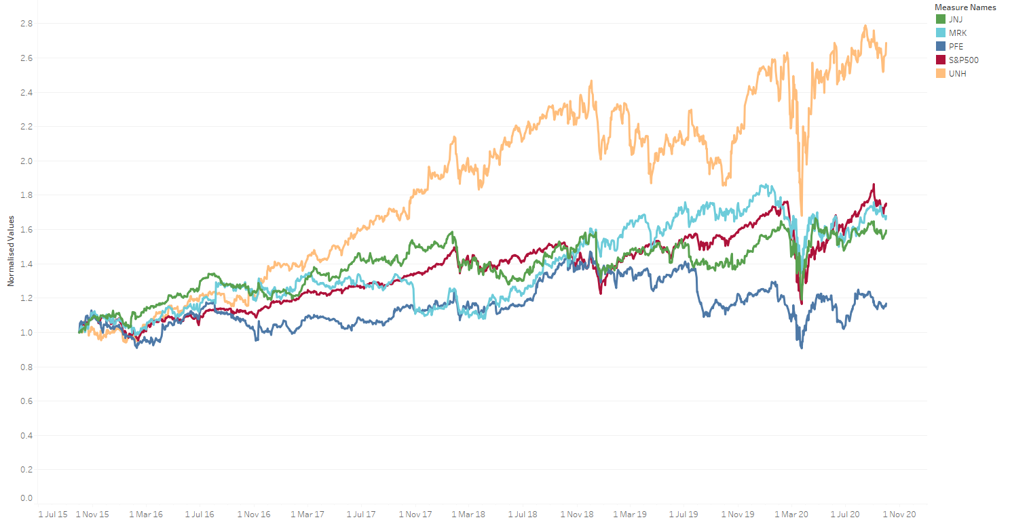
HealthCare
Healthcare industry has performed well even after taking the pandemic hit
Majority of the stocks are either replicating the market movement or outperforming the market

Slide 10
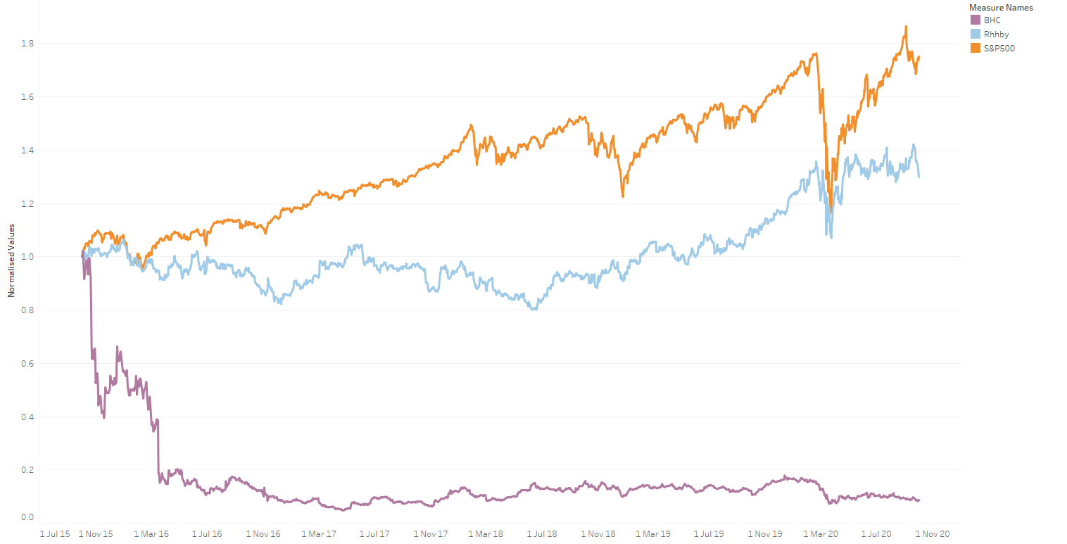
Pharmaceuticals
One of the stocks have outperformed the market
The other one has been not performing well

Slide 11
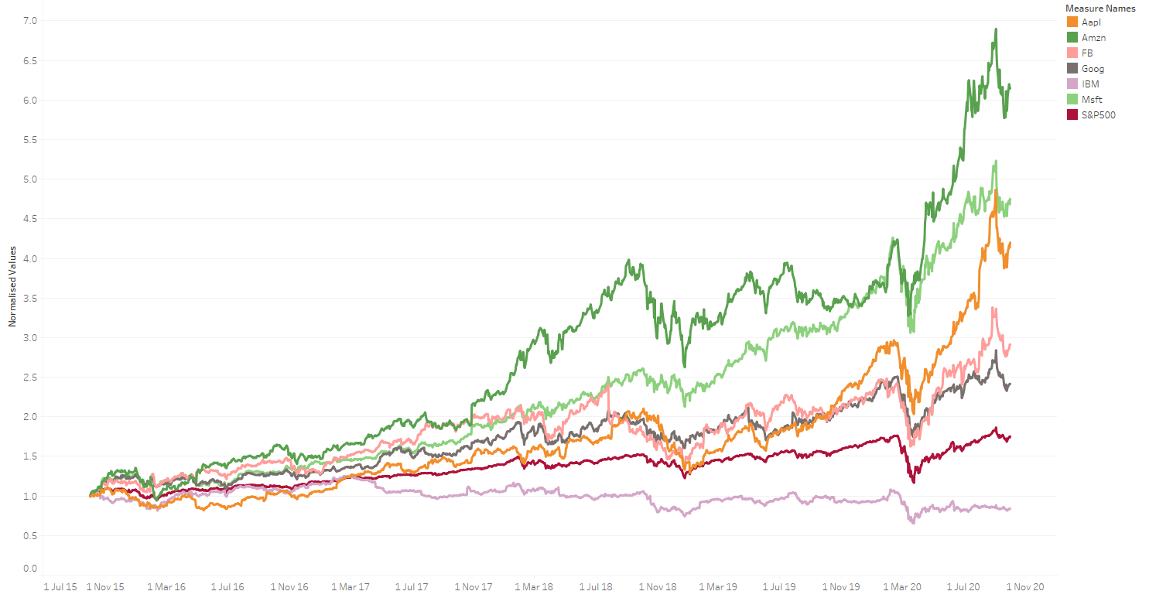
Technology
The Technology industry have been on a boom
The pandemic restrictions has allowed people to take time and engage themselves with the technology they have

Slide 12
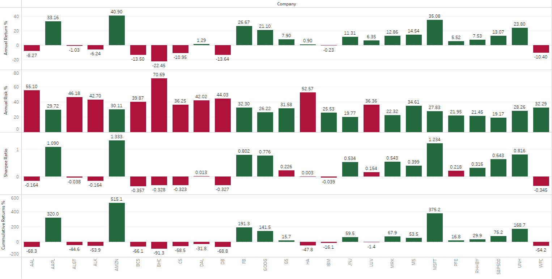
Evaluating the Stocks
Positive annual returns are highlighted in green
Risk greater than 35% is represented in red
Sharpe ratio greater that 0.3 have been represented green
Cumulative Returns greater than 14% have been represented in green

Slide 13
Mr. Patrick Jyengar
Mr. Patrick Jyengar wants to double his capital of $500k
To achieve this goal in the span of 5 years, we need to have a CAGR (Compound annual growth rate) of close to 15%
Our client is close to retirement and wants to lower the risk as much as we can

Slide 14
Mr. Patrick Jyengar’s Portfolio
Apple Inc.
Amazon.com, Inc.
Meta Platforms Inc
Alphabet Inc Class C
Microsoft Corporation
Roche Holdings AG Basel ADR Common Stock
Johnson & Johnson
Merck & Co., Inc.
UnitedHealth Group Inc.
Goldman Sachs Group Inc
Morgan Stanley
Stocks | Investment Amount
AAPL | $ 45454.55
AMZN | $ 45454.55
FB | $ 45454.55
GOOG | $ 45454.55
MSFT | $ 45454.55
RHHBY | $ 45454.55
JNJ | $ 45454.55
MRK | $ 45454.55
UNH | $ 45454.55
GS | $ 45454.55
MS | $ 45454.55

Slide 15
Portfolio Performance
 | Annual Return % | Investment Amount | Year 1 | Year 2 | Year 3 | Year 4 | Year 5
AAPL | 33.16107 | 45454.55 | 60527.76 | 80599.41 | 107327 | 142917.8 | 190310.9
AMZN | 40.89849 | 45454.55 | 64044.77 | 90238.11 | 127144.1 | 179144.2 | 252411.4
FB | 26.66512 | 45454.55 | 57575.06 | 72927.52 | 92373.73 | 117005.3 | 148204.9
GOOG | 21.09715 | 45454.55 | 55044.16 | 66656.91 | 80719.62 | 97749.16 | 118371.5
MSFT | 35.08402 | 45454.55 | 61401.83 | 82944.06 | 112044.2 | 151353.8 | 204454.8
RHHBY | 7.534502 | 45454.55 | 48879.32 | 52562.13 | 56522.42 | 60781.1 | 65360.65
JNJ | 11.30504 | 45454.55 | 50593.21 | 56312.79 | 62678.98 | 69764.87 | 77651.82
MRK | 12.86485 | 45454.55 | 51302.21 | 57902.16 | 65351.18 | 73758.51 | 83247.43
UNH | 23.80441 | 45454.55 | 56274.74 | 69670.61 | 86255.29 | 106787.9 | 132208.1
GS | 7.898465 | 45454.55 | 49044.76 | 52918.54 | 57098.29 | 61608.18 | 66474.28
MS | 14.54206 | 45454.55 | 52064.58 | 59635.84 | 68308.12 | 78241.52 | 89619.45
Expected Returns after 5 years
$ 1,428,315
Risk involved in portfolio
27 %

Slide 16
Mr. Peter Jyengar
Mr. Peter Jyengar wants to get maximum returns in the next 5 years for inorganic expansion of the company
Available capital – $1M
Our client can take high risk in the hopes of higher returns

Slide 17
Mr. Peter Jyengar’s Portfolio
Apple Inc.
Amazon.com, Inc.
Meta Platforms Inc
Alphabet Inc Class C
Microsoft Corporation
Roche Holdings AG Basel ADR Common Stock
Johnson & Johnson
Merck & Co., Inc.
UnitedHealth Group Inc.
Goldman Sachs Group Inc
Morgan Stanley
Delta Airline Inc.
Home Depot Inc
Southwest Airlines Co.
Stocks | Investment Amount
AAPL | 66666.67
AMZN | 66666.67
FB | 66666.67
GOOG | 66666.67
MSFT | 66666.67
RHHBY | 66666.67
JNJ | 66666.67
MRK | 66666.67
PFE | 66666.67
UNH | 66666.67
GS | 66666.67
MS | 66666.67
DAL | 66666.67
HA | 66666.67
LUV | 66666.67

Slide 18
Portfolio Performance
 | Annual Return % | Investment Amount | Year 1 | Year 2 | Year 3 | Year 4 | Year 5
AAPL | 33.16107 | 66666.67 | 88774.05 | 118212.5 | 157413 | 209612.8 | 279122.7
AMZN | 40.89849 | 66666.67 | 93932.33 | 132349.2 | 186478.1 | 262744.8 | 370203.4
FB | 26.66512 | 66666.67 | 84443.42 | 106960.4 | 135481.5 | 171607.8 | 217367.2
GOOG | 21.09715 | 66666.67 | 80731.44 | 97763.47 | 118388.8 | 143365.4 | 173611.5
MSFT | 35.08402 | 66666.67 | 90056.02 | 121651.3 | 164331.5 | 221985.5 | 299867
RHHBY | 7.534502 | 66666.67 | 71689.67 | 77091.13 | 82899.56 | 89145.63 | 95862.31
JNJ | 11.30504 | 66666.67 | 74203.37 | 82592.09 | 91929.16 | 102321.8 | 113889.3
MRK | 12.86485 | 66666.67 | 75243.23 | 84923.16 | 95848.39 | 108179.1 | 122096.2
PFE | 5.524649 | 66666.67 | 70349.77 | 74236.35 | 78337.65 | 82665.53 | 87232.51
UNH | 23.80441 | 66666.67 | 82536.28 | 102183.6 | 126507.7 | 156622.2 | 193905.1
GS | 7.898465 | 66666.67 | 71932.31 | 77613.86 | 83744.16 | 90358.66 | 97495.61
MS | 14.54206 | 66666.67 | 76361.37 | 87465.88 | 100185.2 | 114754.2 | 131441.8
DAL | 1.29362 | 66666.67 | 67529.08 | 68402.65 | 69287.52 | 70183.84 | 71091.75
HA | 0.902731 | 66666.67 | 67268.49 | 67875.74 | 68488.48 | 69106.75 | 69730.6
LUV | 6.353628 | 66666.67 | 70902.42 | 75407.3 | 80198.4 | 85293.91 | 90713.17
Expected Returns after 5 years
$ 2,413,630
Risk involved in portfolio
30.47 %

Slide 19
Recommendations
After a couple of years, the Aviation Industry may start performing well.
The Portfolio’s need to be revised every year in order to make the most out of the investment

